Slide 1
Bipedal Wheeled Robot for Ergodic Coverage
Preliminary Design Review
University of Massachusetts Amherst
Team 27: Hikaru Takano, Owen Davis, Eleanor Powell, Xin Hung Chan
With support from Professor Hossein Pishro-Nik and Professor Ahmad Ghasemi
Notes:
All
Notes:
Change Hikaru’s name
Reorder Owen and Eleanor for smoother transition from intro slide
Add Slide before Ergodic Converage saying our robot will use ergodic coverage → ergodic coverage
On Flow matching ergodic coverage slide, is middle section “traditional approach” or “how we differ from traditional approach”
Add mention of “research project” in goal or problem statement
Add images or diagrams or screenshots of papers demonstrating that we have looked and there really are no previous implementations, Prove we have done due-diligence
Red exes next to each lol
Add images for project scope: just little diagrams to break up the text {picture of boyden, etc.)
Back of the napkin calcs for power consumption
Maybe add numbers instead of words with a key on the side for first block diagram so words are bigger

Slide 2
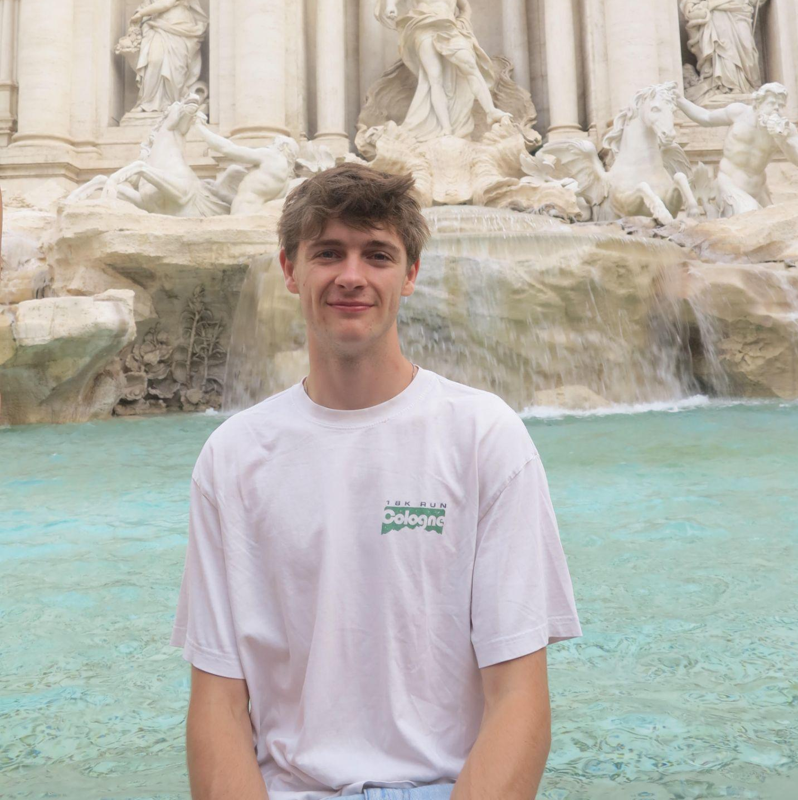
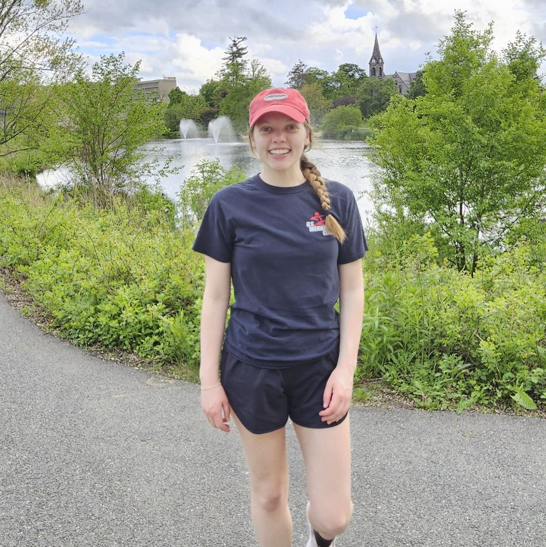


Team Members
Team 27 Preliminary Design Review
University of Massachusetts Amherst
Owen Davis
EE
Control Theory and Motors
Eleanor Powell MechE
Mechanical Design
Hikaru Takano
CompE, Physics, Math
Ergodic Coverage and Simulation
Xin Hung Chan
CompE
PCB Design and Embedded Processing

Slide 3
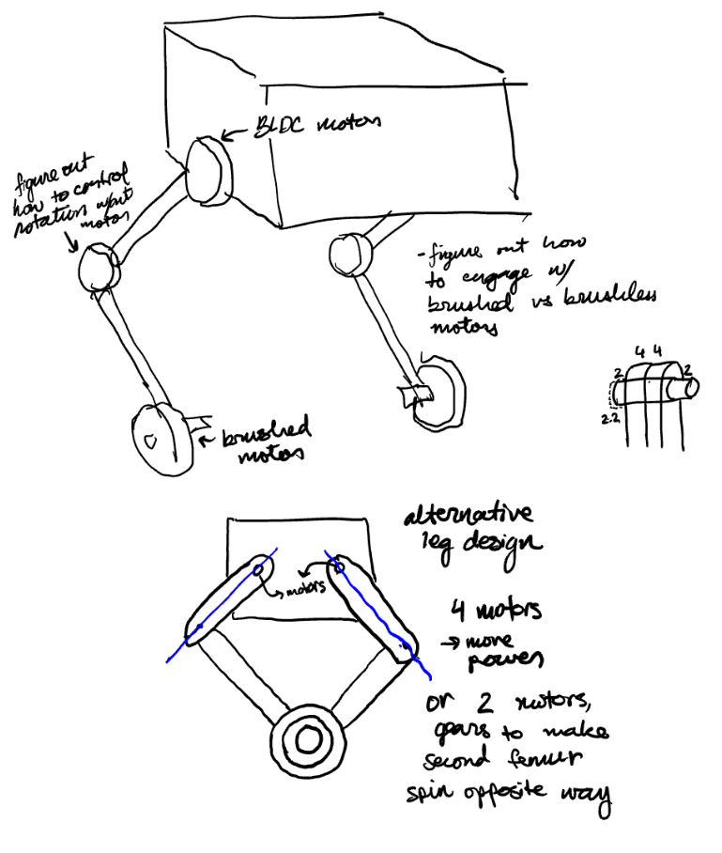
Outline
Team 27 Preliminary Design Review
University of Massachusetts Amherst
Introduction
Survey of Similar Solutions
Preliminary Design Plan
MDR Deliverables
Project Management
Appendices

Slide 4
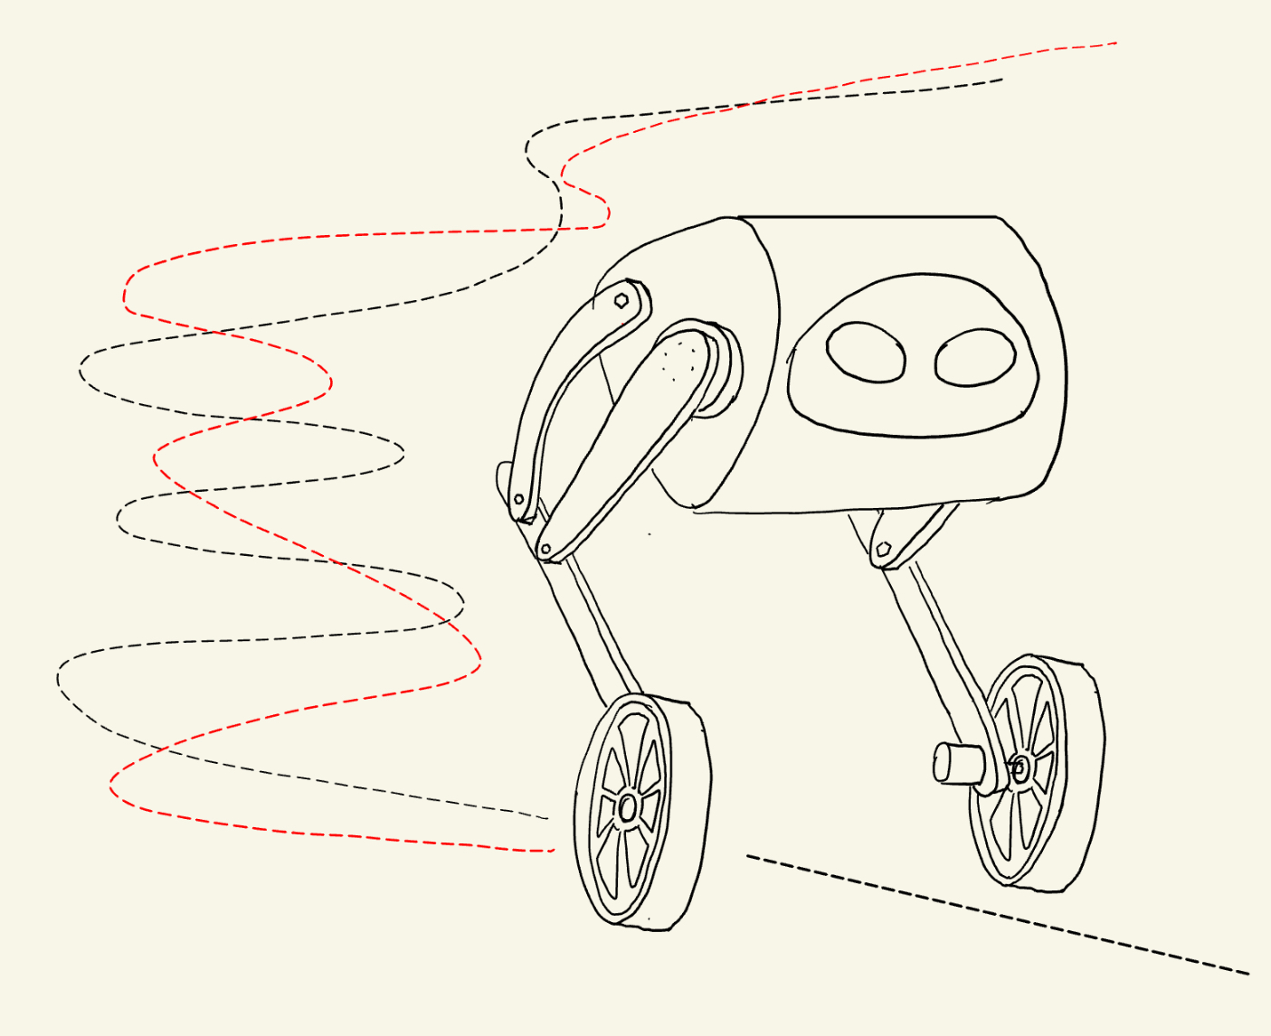
Project Overview
Team 27 Preliminary Design Review
University of Massachusetts Amherst
Actual Trajectory
Our team will implement and evaluate an Ergodic Coverage algorithm on a bipedal, wheeled robot
Type of project: Research
Target Trajectory

Slide 5
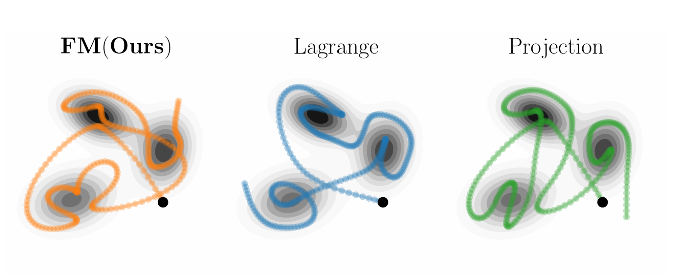
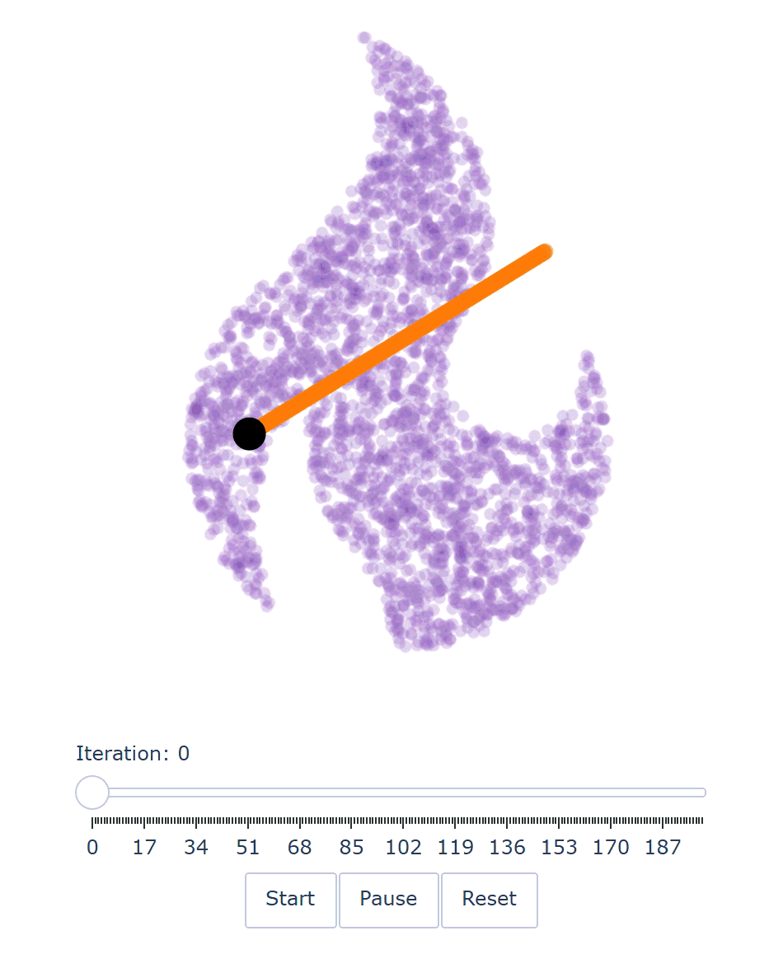
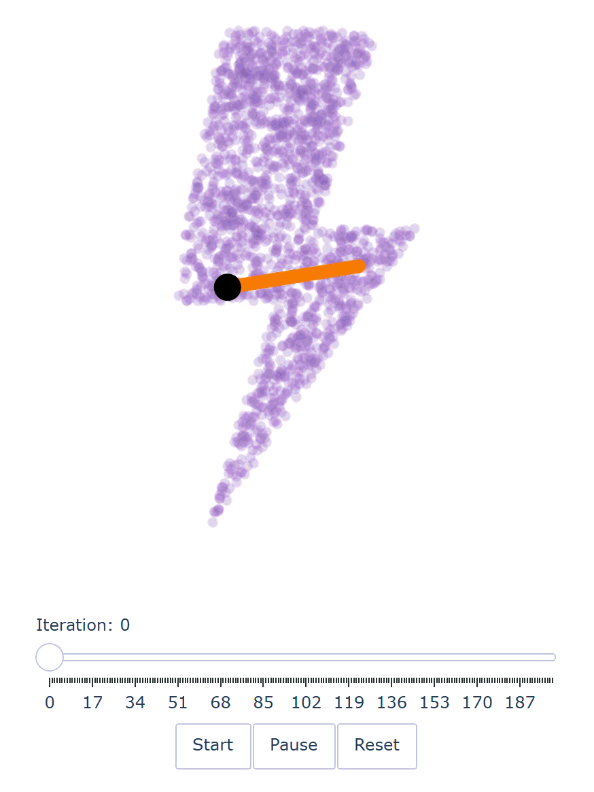
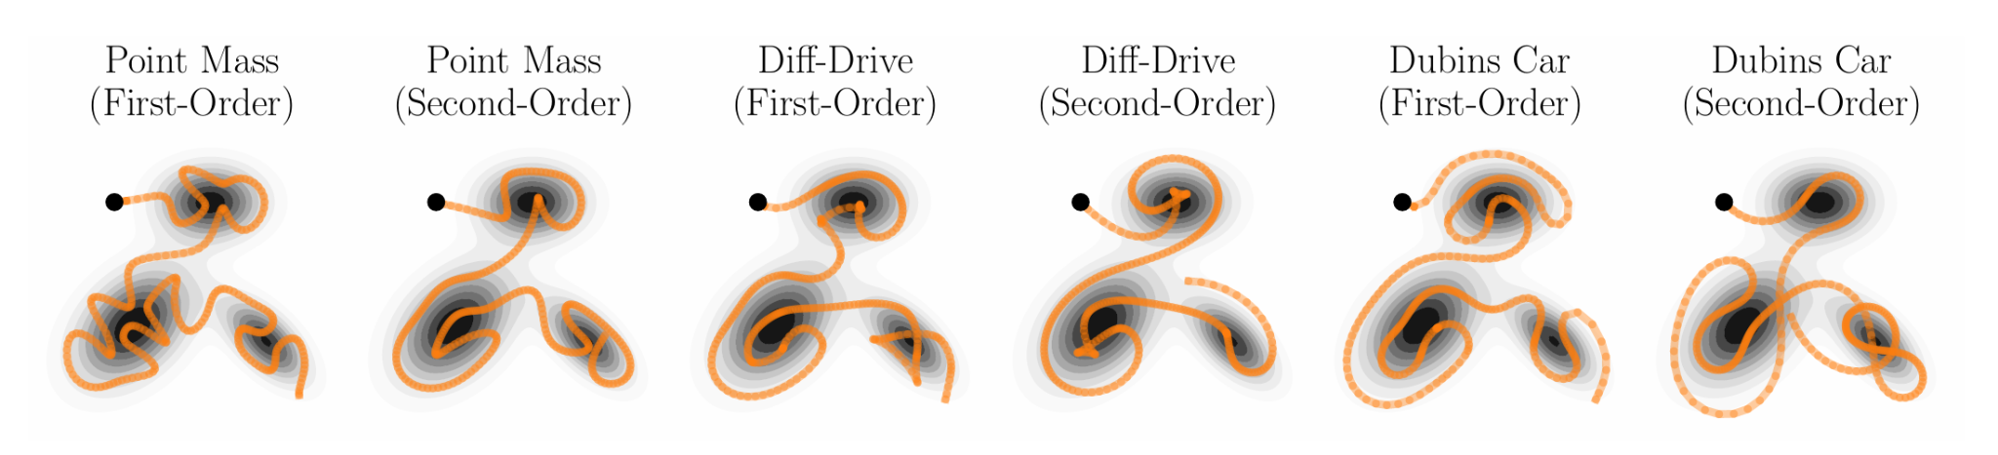
Background: What is Ergodic Coverage?
Team 27 Preliminary Design Review
University of Massachusetts Amherst
A trajectory planning method.
The goal is to make the time-averaged spatial distribution of the robot's trajectory match a desired target distribution (such as a map showing where survivors are likely located in a search-and-rescue mission).
Examples of a specific ergodic coverage algorithm
Sun, M., Pinosky, A., & Murphey, T. (2025). Flow matching ergodic coverage. Robotics: Science and Systems XXI.
https://doi.org/10.15607/rss.2025.xxi.051
Notes:
HR

Slide 6
Ergodic Trajectory by Learned Pushforward Maps
University of Massachusetts Amherst
Same goal
The robot spends more time in important areas and less time in others, according to a target map.
Classical Approach
Directly adjust the robot’s path to achieve the desired coverage.
Pushforward Maps Approach
Start with a path that covers an area uniformly. Train a neural network to learn how to reshape it to achieve the desired coverage.
Benefit of a learned pushforward map: train once, then generate unlimited trajectories with a single forward pass
Aghazadeh, E., Malekzadeh, M., Ghasemi, A., & Pishro-Nik, H. (2026). Ergodic trajectory design by learned pushforward maps: Provable coverage via conditional flow matching. Advances in Neural Information Processing Systems, 39.
Notes:
HR

Slide 7
Problem Statement
Team 27 Preliminary Design Review
University of Massachusetts Amherst
Ergodic Trajectory by Learned Pushforward Maps has only been tested in simulations
Implementation on a physical mobile robot remains unexplored
Real-world robotic constraints have not yet been addressed:
Power consumption
Battery life
Maneuverability
On-board computational limits
Notes:
HR

Slide 8
Goal
Team 27 Preliminary Design Review
University of Massachusetts Amherst
Objective: Design and build a bipedal, wheeled robot capable of autonomous navigation using ergodic coverage.
Trajectory Planning: Generate trajectories that account for the robot’s physical and computational constraints.
Input: A spatial distribution map assigning importance or priority to locations in the environment.
Autonomous Navigation: Enable the robot to independently follow the planned trajectory.
Research Goal: Experimentally implement and evaluate ergodic coverage on a physical robot under real-world constraints.
Notes:
HR

Slide 9
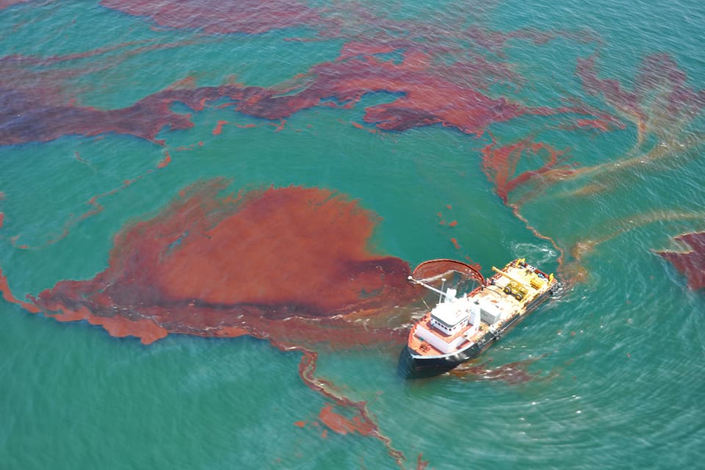
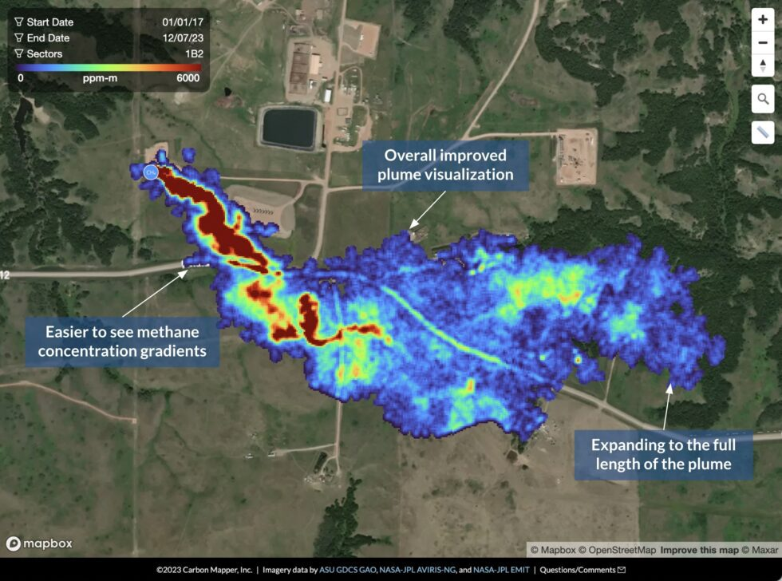
Potential applications
Team 27 Preliminary Design Review
University of Massachusetts Amherst
Search and rescue: Prioritize high-probability search areas.
Wildlife Monitoring: Track endangered species and monitor habitats.
Precision Pest and Weed Detection: Target crop stress, pests, and weeds.
Hazardous Plume Tracking: Map pollutant concentrations and track spread.
Notes:
HR

Slide 10
Potential applications
Team 27 Preliminary Design Review
University of Massachusetts Amherst
Search and rescue: Prioritize high-probability search areas.
Wildlife Monitoring: Track endangered species and monitor habitats.
Precision Pest and Weed Detection: Target crop stress, pests, and weeds.
Hazardous Plume Tracking: Map pollutant concentrations and track spread.
Notes:
HR

Slide 11
Potential applications
Team 27 Preliminary Design Review
University of Massachusetts Amherst
Search and rescue: Prioritize high-probability search areas.
Wildlife Monitoring: Track endangered species and monitor habitats.
Precision Pest and Weed Detection: Target crop stress, pests, and weeds.
Hazardous Plume Tracking: Map pollutant concentrations and track spread.
Notes:
HR

Slide 12
Potential applications
Team 27 Preliminary Design Review
University of Massachusetts Amherst
Search and rescue: Prioritize high-probability search areas.
Wildlife Monitoring: Track endangered species and monitor habitats.
Precision Pest and Weed Detection: Target crop stress, pests, and weeds.
Hazardous Plume Tracking: Map pollutant concentrations and track spread.
Notes:
HR

Slide 13
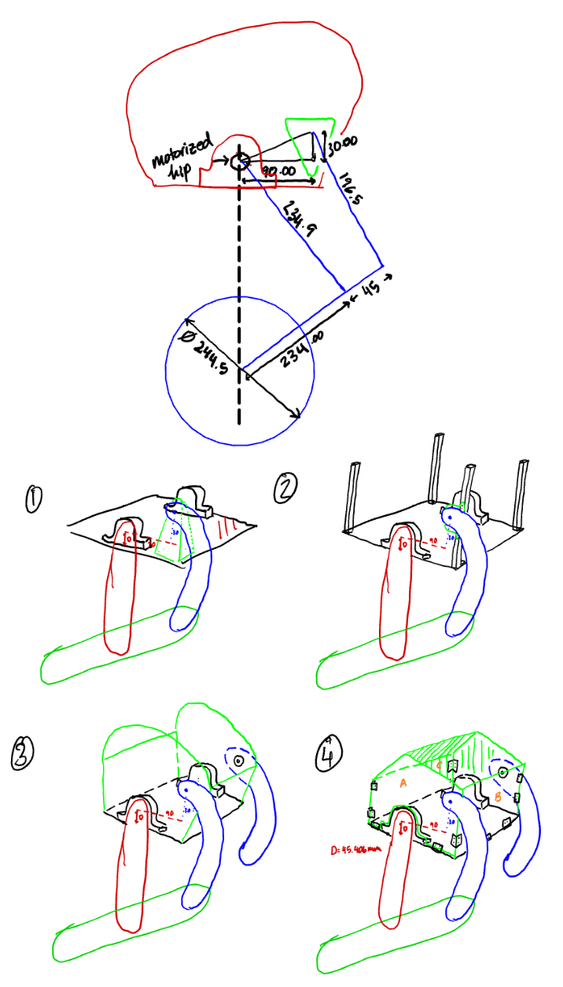
Outline
Team 27 Preliminary Design Review
University of Massachusetts Amherst
Introduction
Survey of Similar Solutions
Preliminary Design Plan
MDR Deliverables
Project Management
Appendices

Slide 14
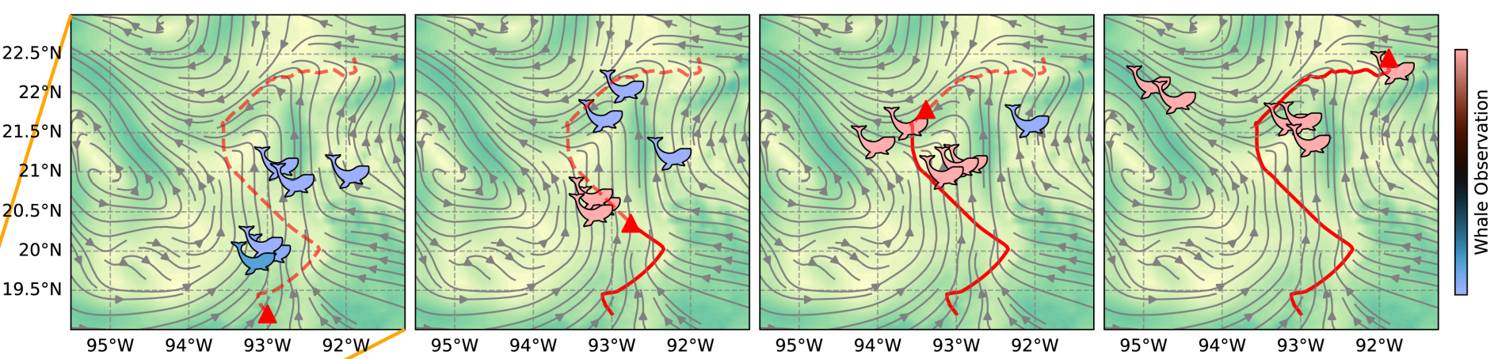
Existing Solutions
Team 27 Preliminary Design Review
University of Massachusetts Amherst
No existing solutions for experimental implementations of ergodic coverage with learned pushforward maps
Simulation of ergodic coverage to track whales
Fig. 1: Autonomous Migratory Tracking over the Gulf ^{[2]}
Hughes, C., Liu, Y., Lahrach, Y., Engdahl, J., Warren, H., Lee, D., Ramos, F., Miles, T., & Abraham, I. (2026).
Asymptotically optimal ergodic coverage on generalized motion fields. Robotics: Science and Systems XXII. https://doi.org/10.15607/rss.2026.xxii.136

Slide 15
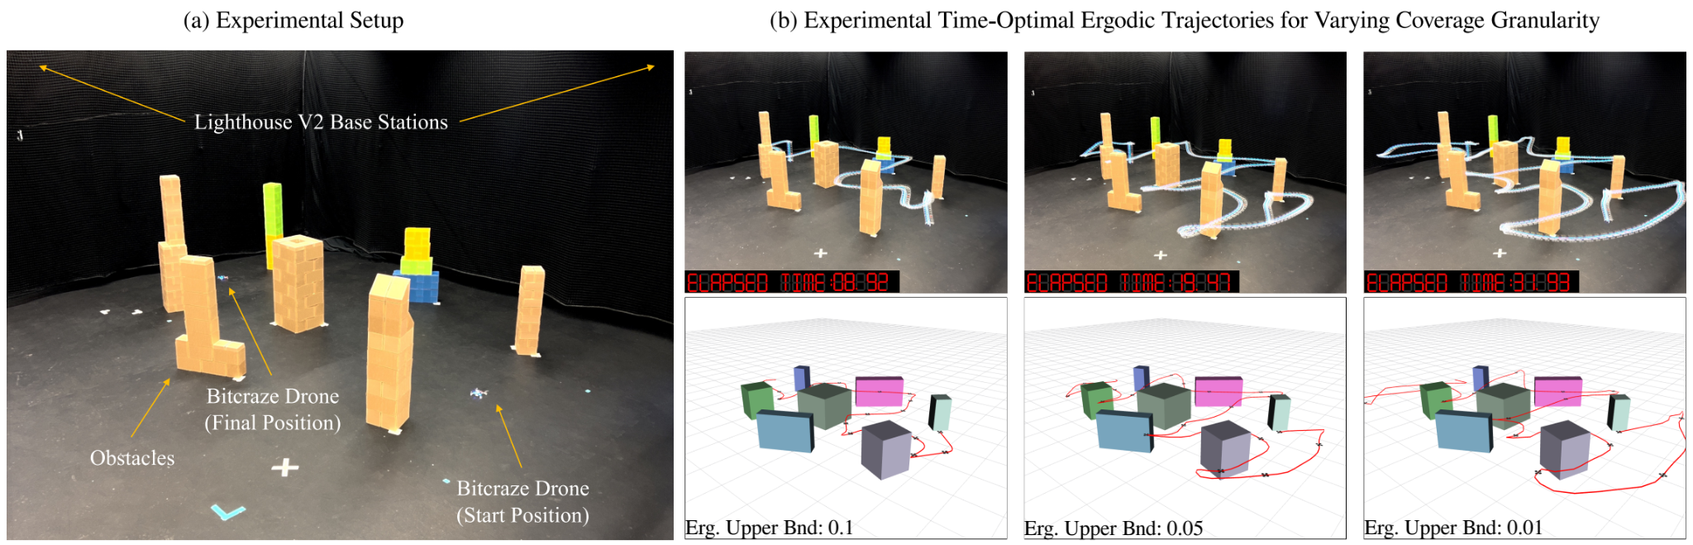
Existing Solutions
Team 27 Preliminary Design Review
University of Massachusetts Amherst
Experimental implementation of ergodic coverage on drones
Fig. 2: Experimental Time-Optimal Ergodic Search Results^{[3]}
Sun, M., Pinosky, A., & Murphey, T. (2025). Flow matching ergodic coverage. Robotics: Science and Systems XXI.
https://doi.org/10.15607/rss.2025.xxi.051

Slide 16
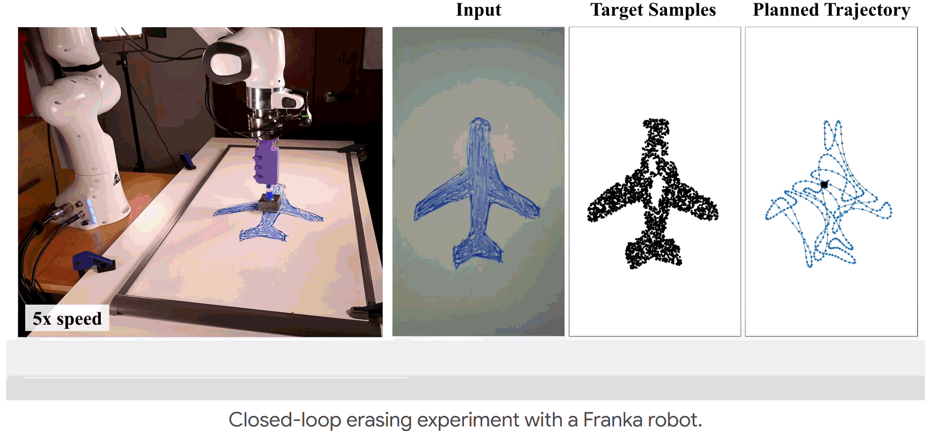
Existing Solutions
Team 27 Preliminary Design Review
University of Massachusetts Amherst
Experimental implementation of ergodic coverage on robotic arm
Fig. 3: Closed-loop erasing experiment with robotic arm^{[1]}
Dong, D., Berger, H., & Abraham, I. (2023). Time Optimal Ergodic Search. Robotics: Science and Systems XIX.
https://doi.org/10.15607/rss.2023.xix.082

Slide 17
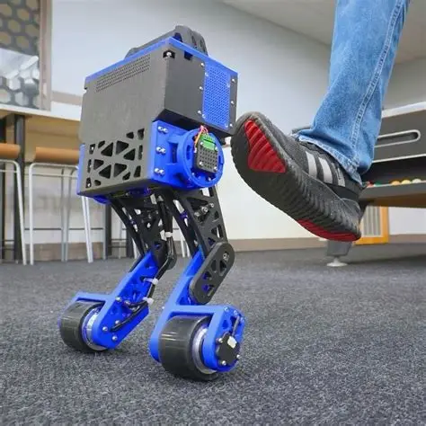
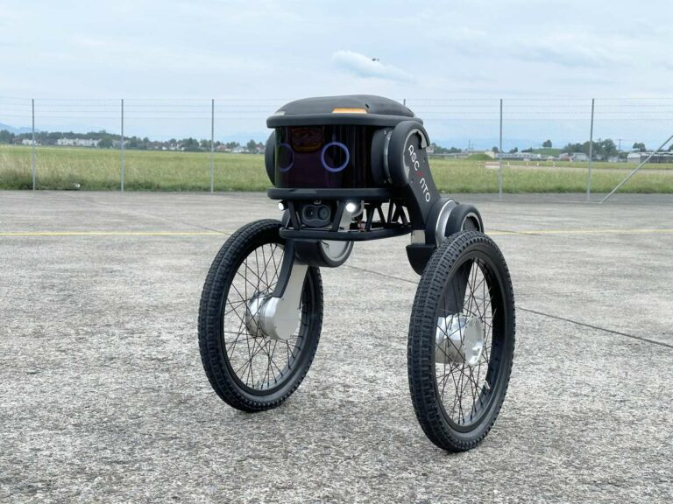
Existing Wheeled Bipedal robots
University of Massachusetts Amherst
Professional: Ascento Guard Robot
Hobbyist: Aaed Musa’s “Ice Skater Bot”

Slide 18
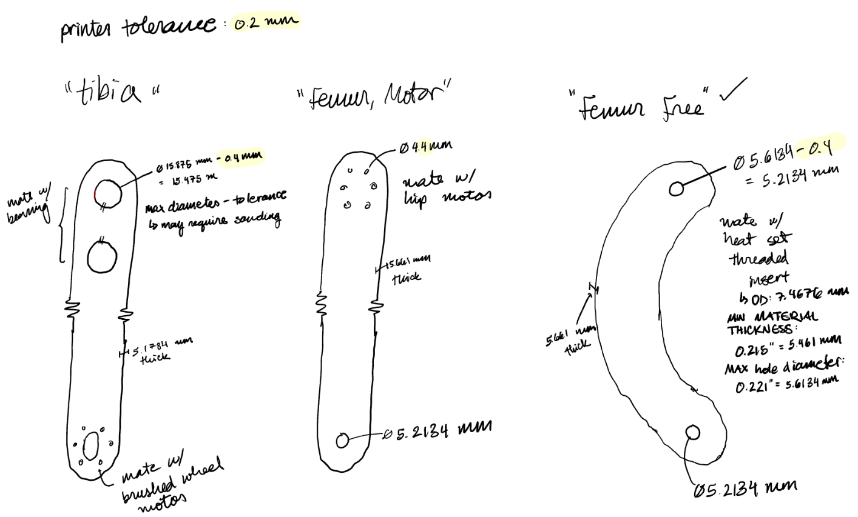
Outline
Team 27 Preliminary Design Review
University of Massachusetts Amherst
Introduction
Survey of Similar Solutions
Preliminary Design Plan
MDR Deliverables
Project Management
Appendices

Slide 19
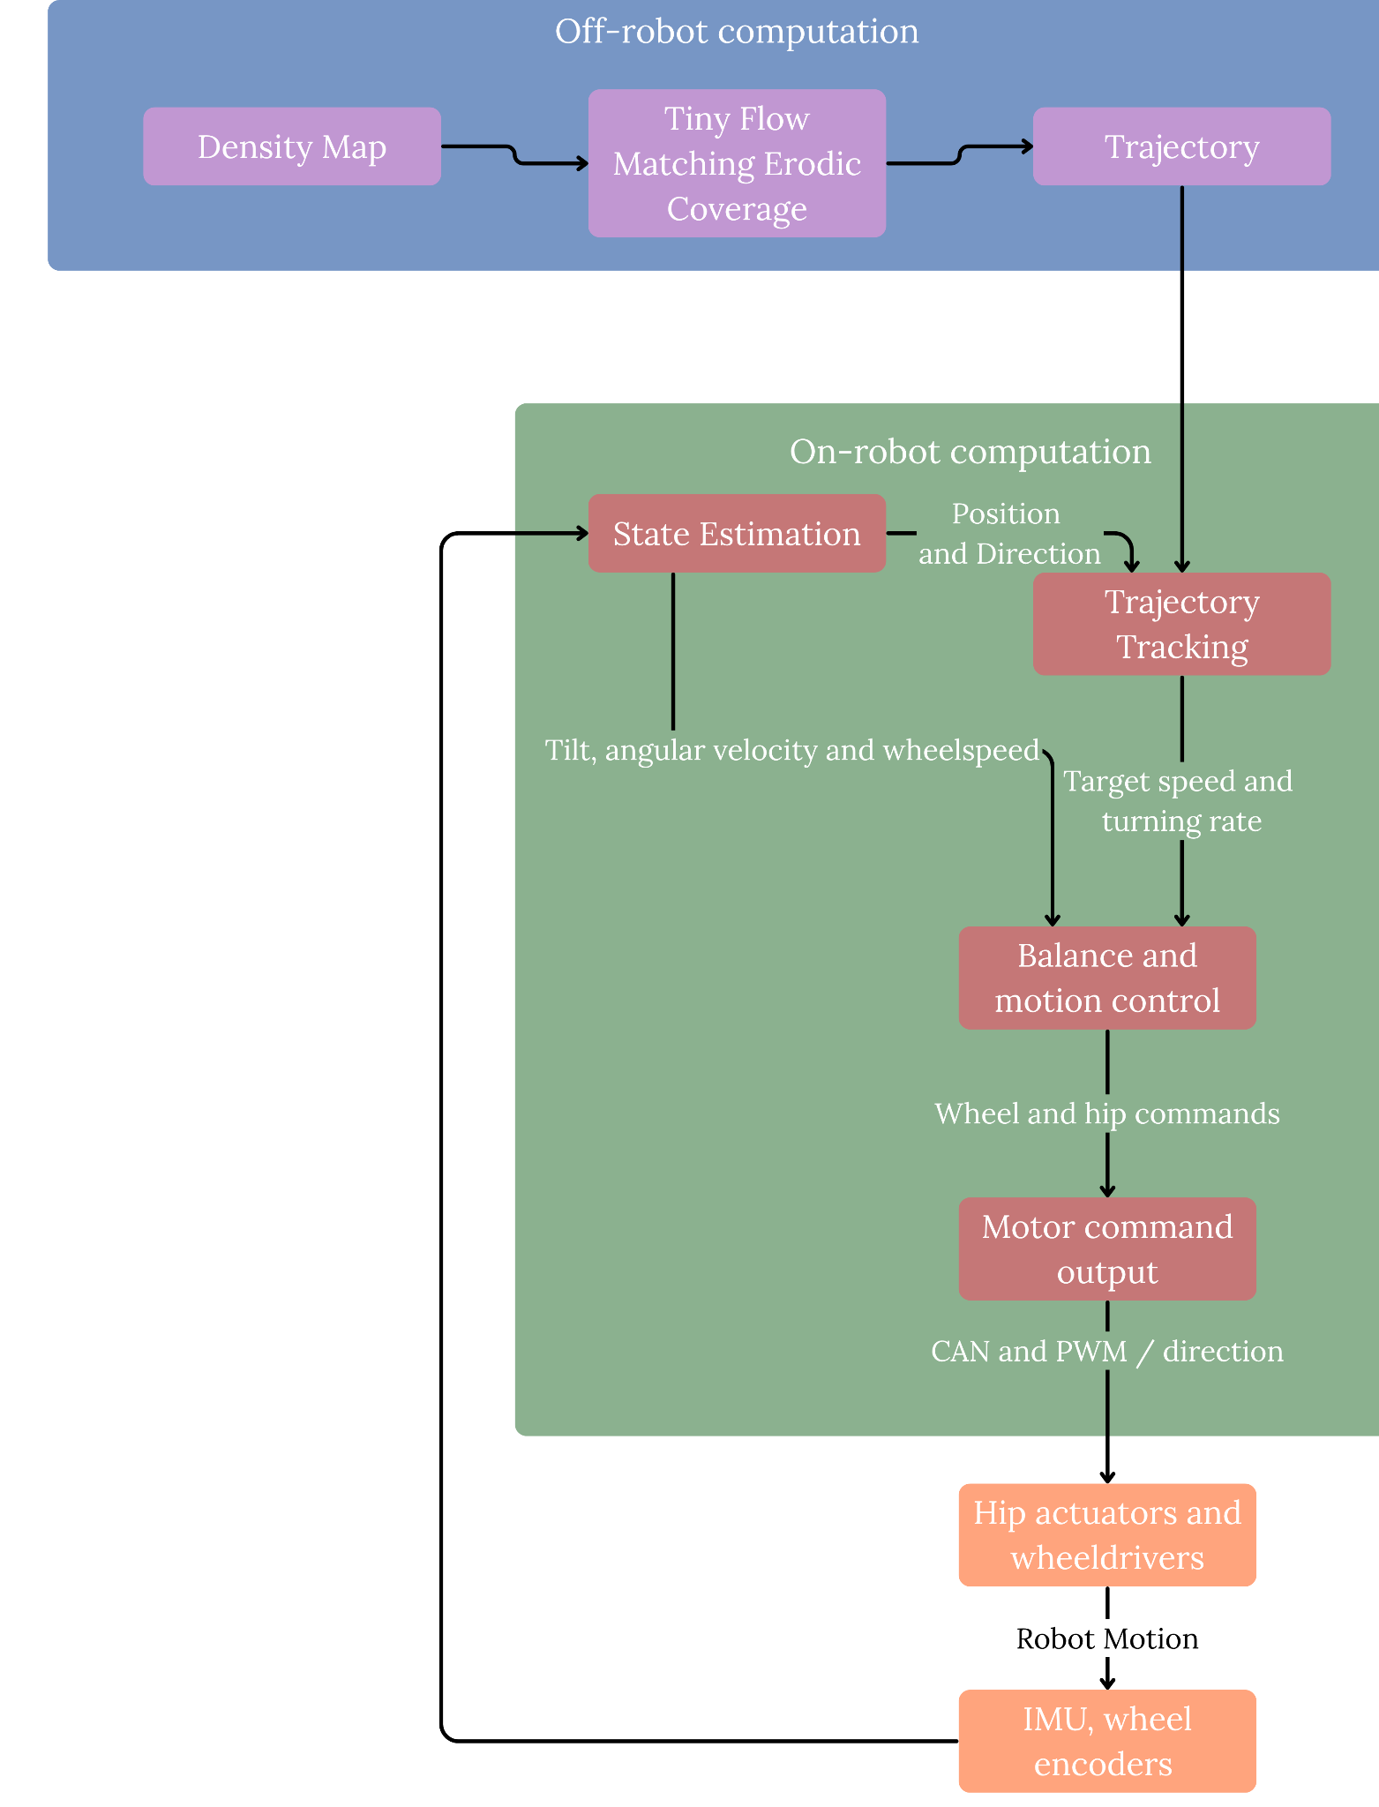

Project Block Diagram Overview
Team 27 Preliminary Design Review
University of Massachusetts Amherst
Network Weights
Key:
Off robot computation
On Robot comp
Actuators

Slide 20
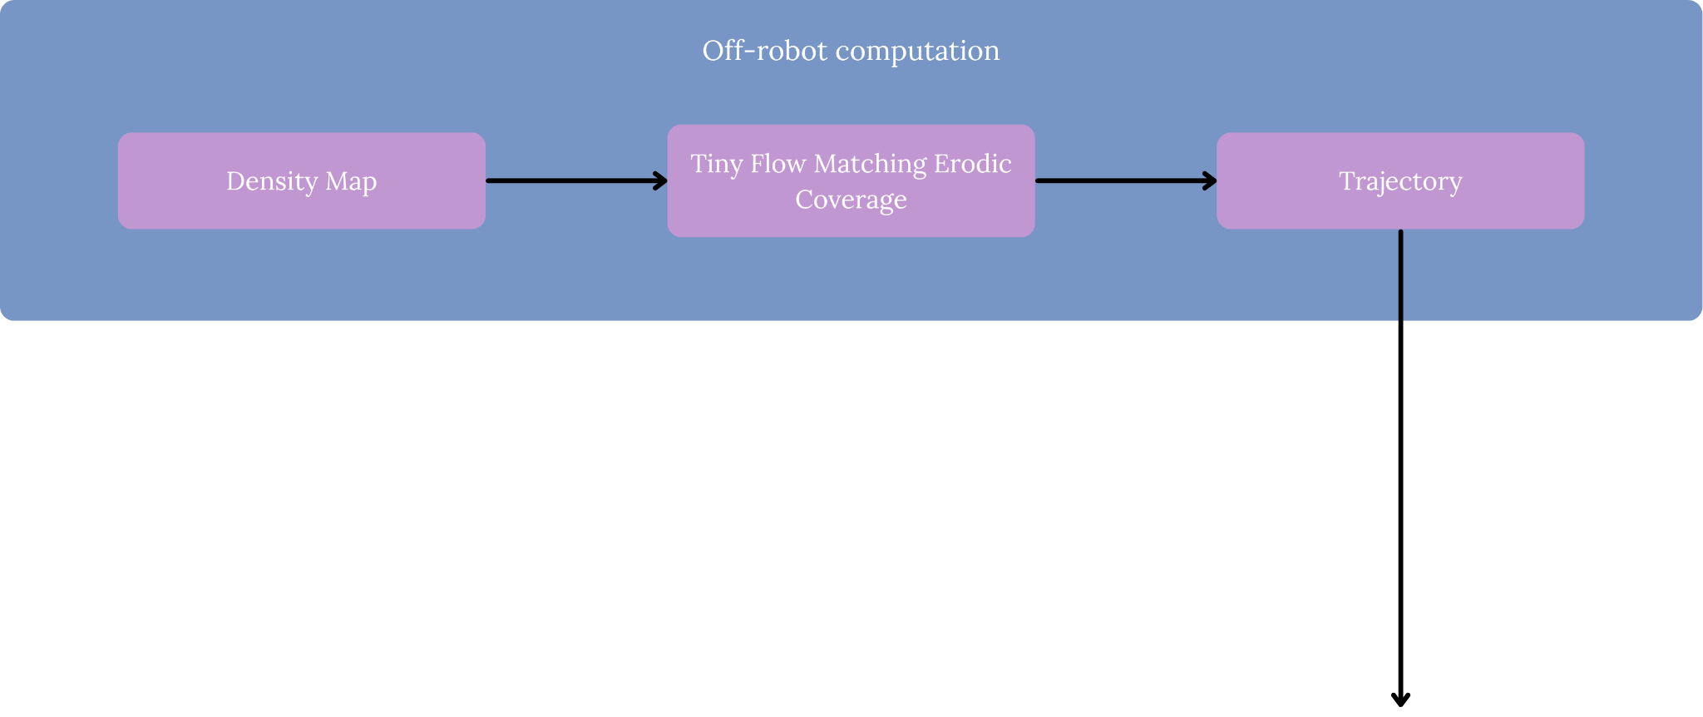
Off-Robot Computation
Team 27 Preliminary Design Review
University of Massachusetts Amherst
Project Block Diagram
Network Weights

Slide 21
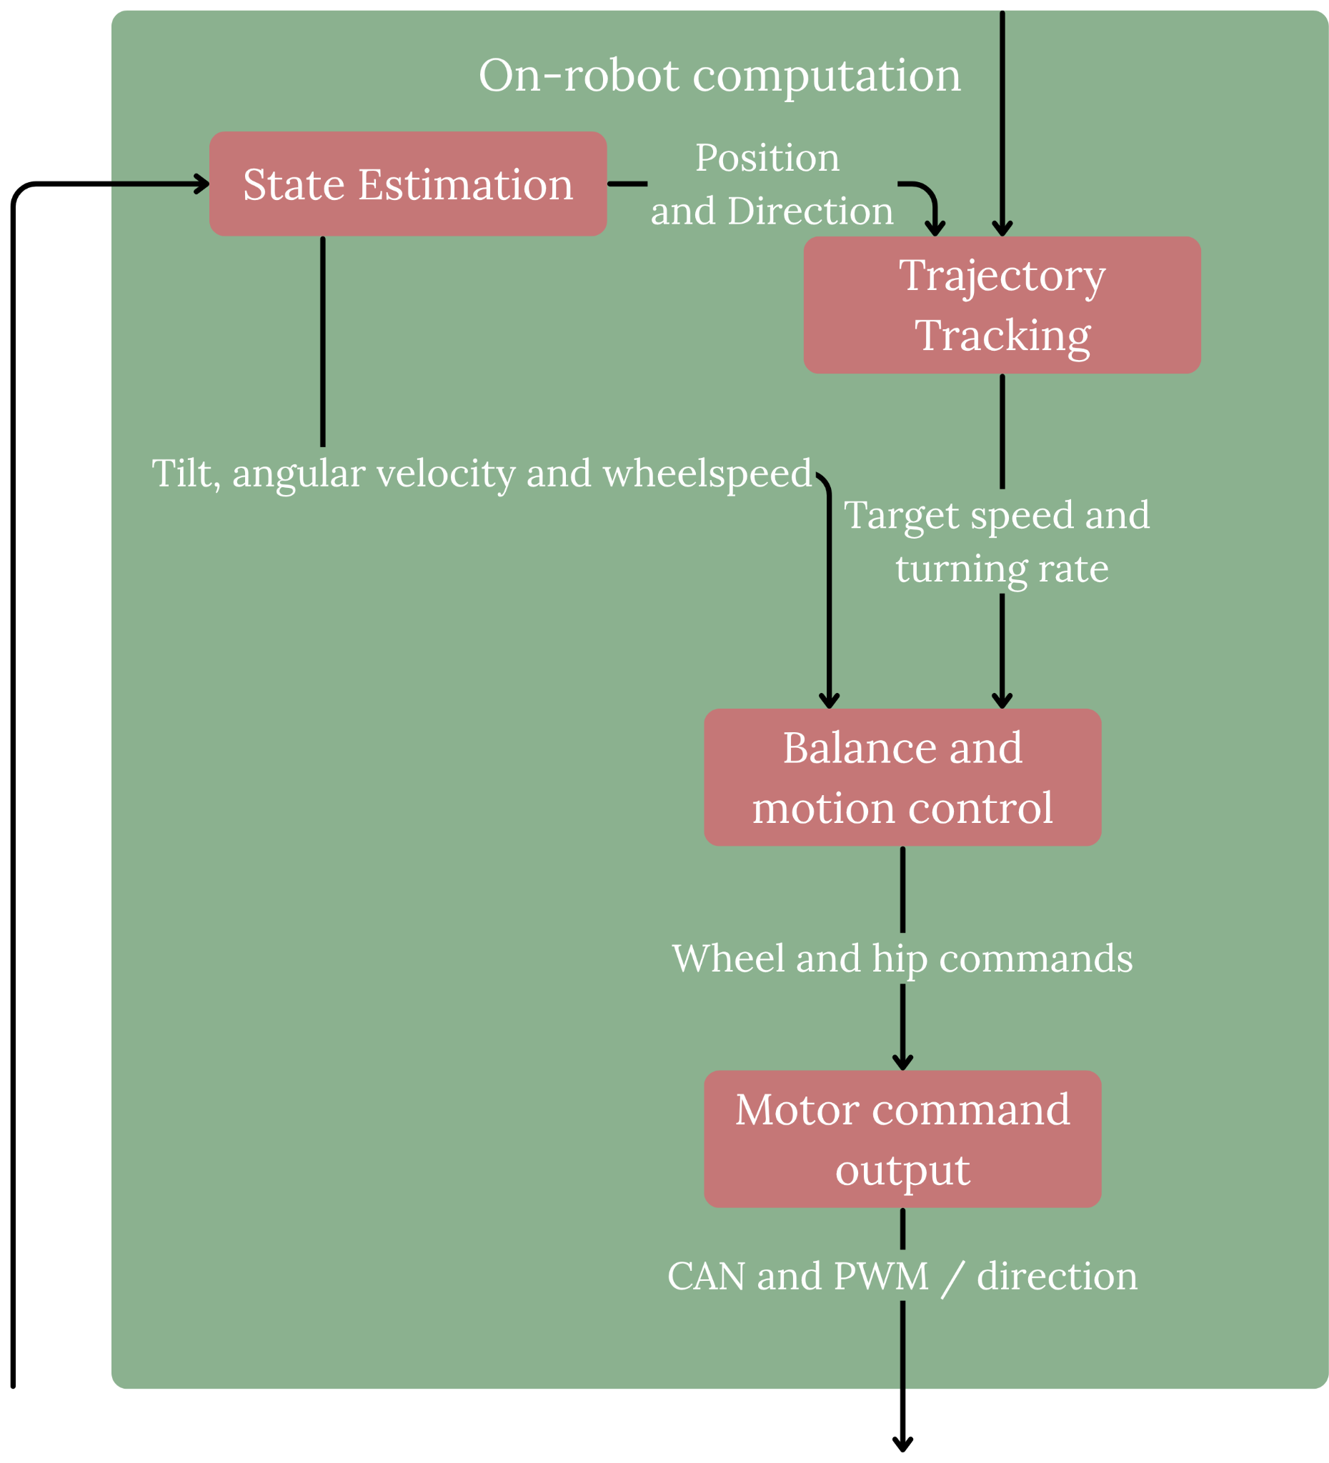
On-Robot Computation
Team 27 Preliminary Design Review
University of Massachusetts Amherst
Project Block Diagram

Slide 22

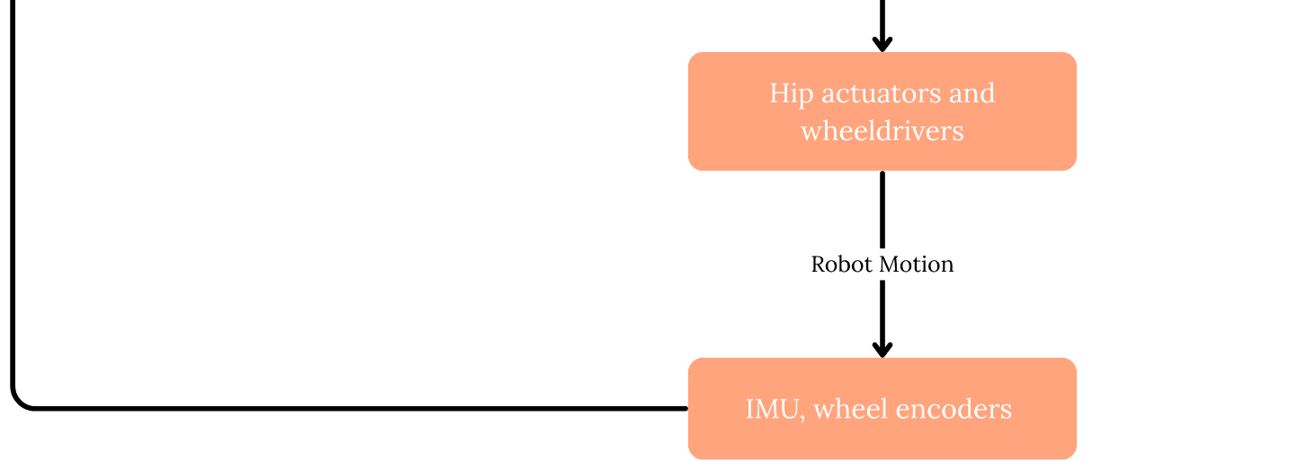
Actuators
Team 27 Preliminary Design Review
University of Massachusetts Amherst
Project Block Diagram

Slide 23
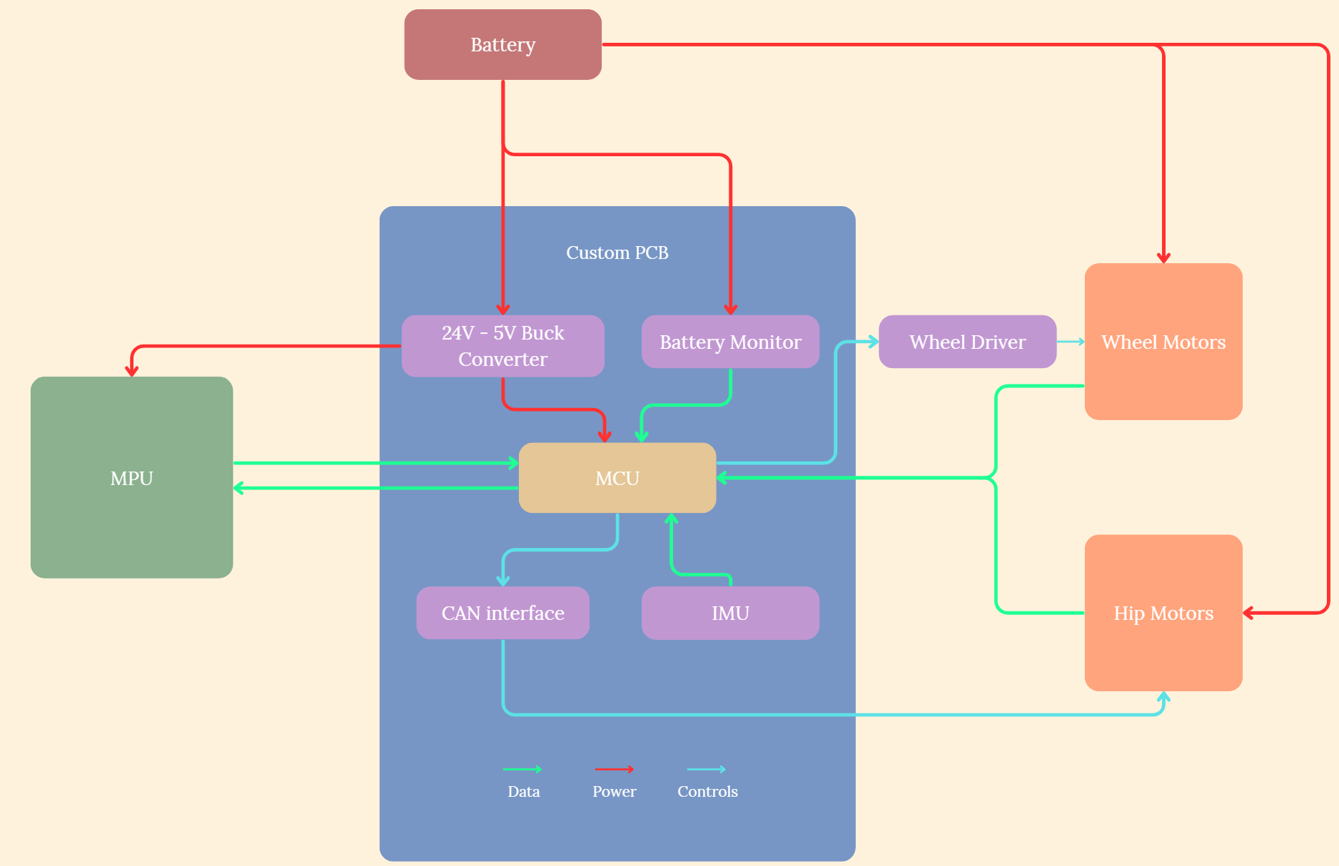


Hardware Block Diagram
Team 27 Preliminary Design Review
University of Massachusetts Amherst

Slide 24
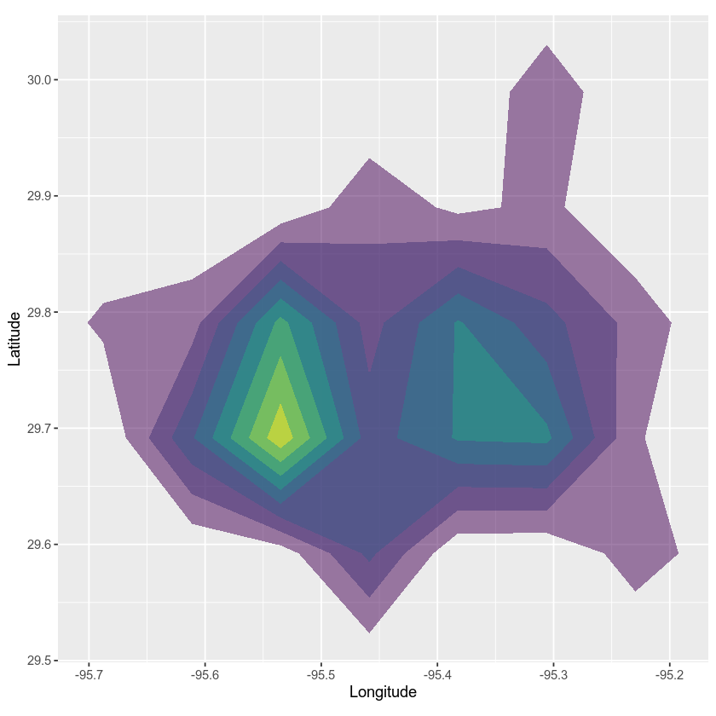
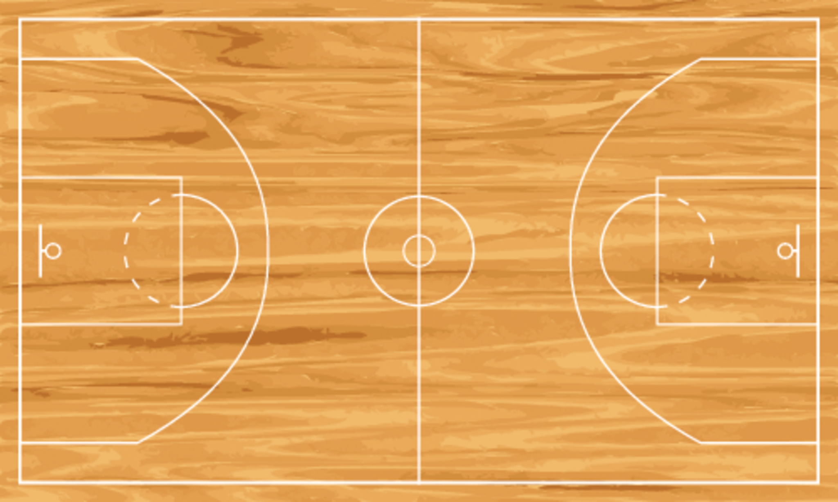
Project scope
Team 27 Preliminary Design Review
University of Massachusetts Amherst
Input
A spatial density map
Notes:
HR
Chopping Block: Redistribute key points to other slides prolly

Slide 25
Project scope
Team 27 Preliminary Design Review
University of Massachusetts Amherst
Input
A spatial density map
Research Objective
Make the robot’s time spent in each region proportional to its priority, within mobility and onboard computing limits.
Notes:
HR
Chopping Block: Redistribute key points to other slides prolly

Slide 26
Project scope
Team 27 Preliminary Design Review
University of Massachusetts Amherst
Input
A spatial density map
Research Objective
Make the robot’s time spent in each region proportional to its priority, within mobility and onboard computing limits.
Project Contribution
Implement and evaluate flow-matching ergodic coverage on a bipedal wheeled robot, measuring:
Coverage quality
Trajectory tracking error
Energy consumption
Notes:
HR
Chopping Block: Redistribute key points to other slides prolly

Slide 27
Project scope
Team 27 Preliminary Design Review
University of Massachusetts Amherst
Input
A spatial density map
Research Objective
Make the robot’s time spent in each region proportional to its priority, within mobility and onboard computing limits.
Project Contribution
Implement and evaluate flow-matching ergodic coverage on a bipedal wheeled robot, measuring:
Coverage quality
Trajectory tracking error
Energy consumption
Initial Test Environment
A defined area of an indoor basketball court with known boundaries and a flat surface.
Notes:
HR
Chopping Block: Redistribute key points to other slides prolly

Slide 28
Specifications
University of Massachusetts Amherst
Mass
Hip Motor (Robstride 01): 380g
Combined Hip Motor Mass: 760g
2 Wheel Motors: 560g
Battery: 800g
Electronics: 400g
Printed parts: 500g
Chassis (aluminum): 700g
Total: 4.1kg (generous)
Performance
Runtime: 49.4 mins
Max speed: 0.44 m/s
Distance coverable: 1.3 km
Notes:
EP

Slide 29
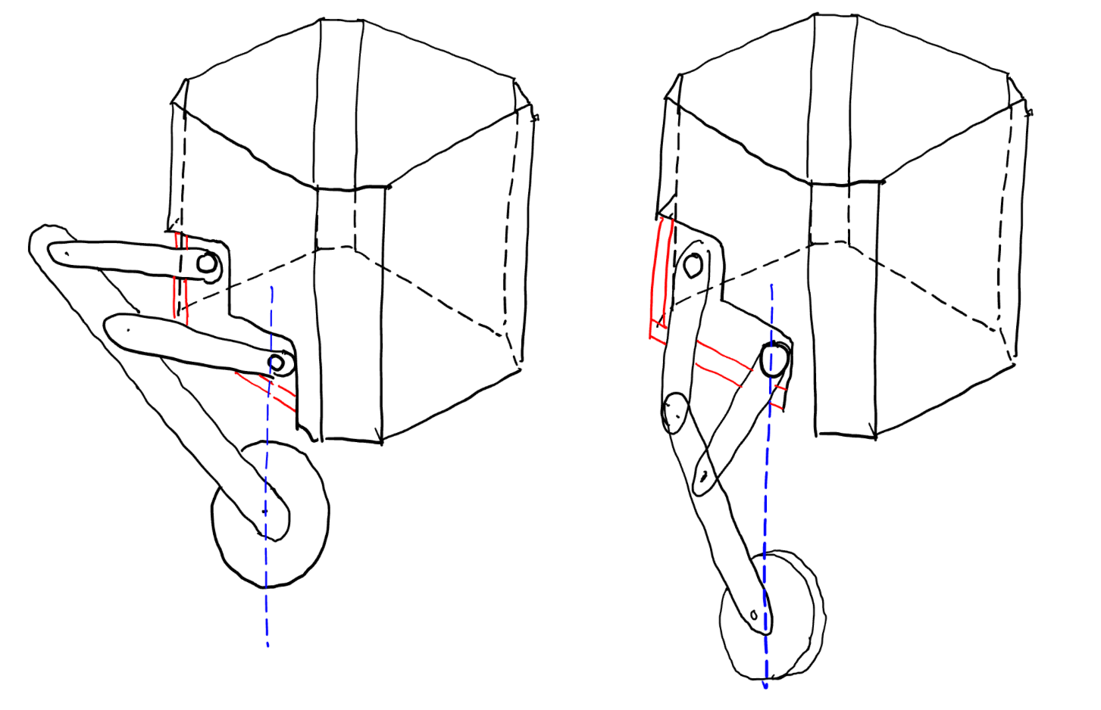
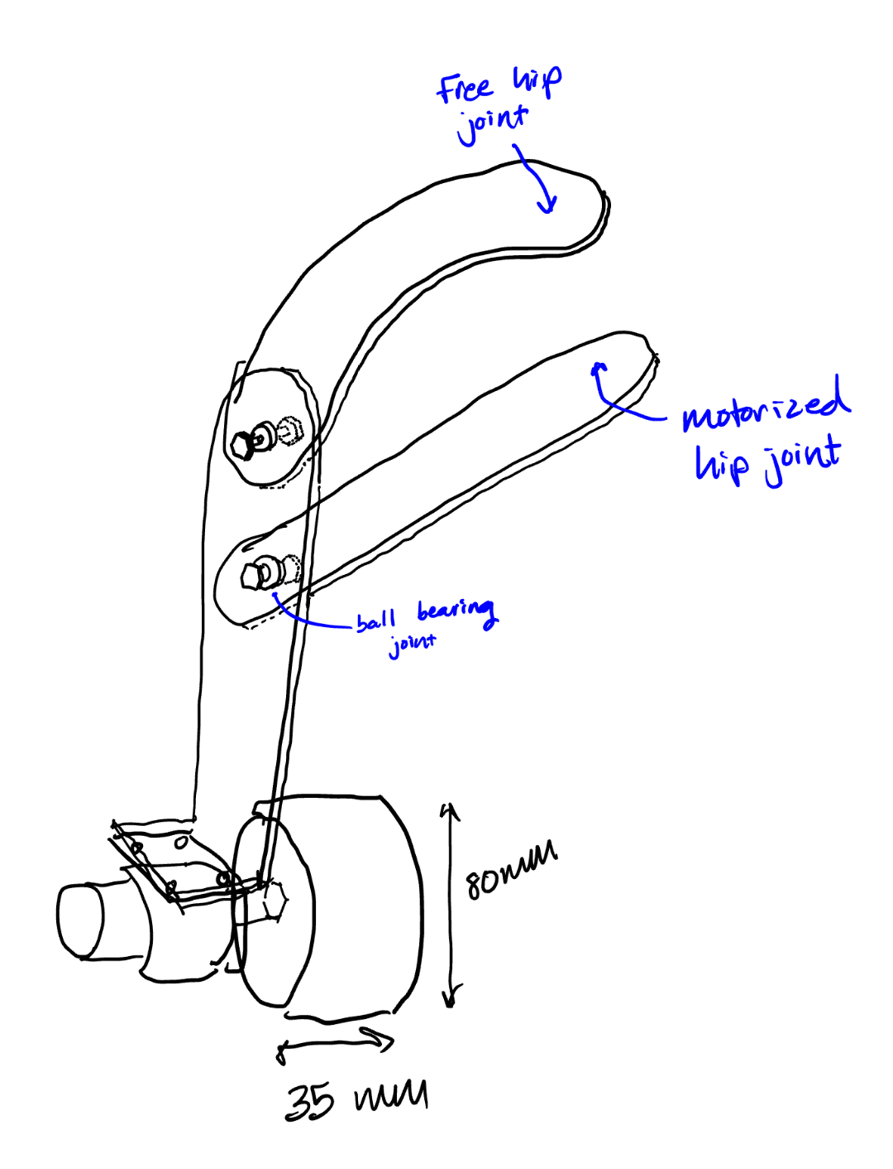
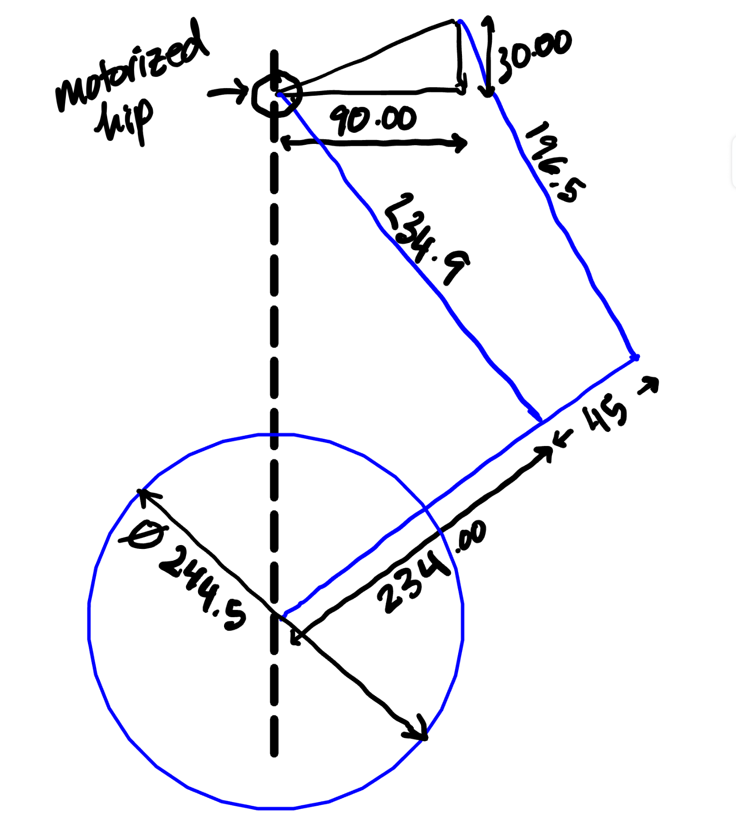
Design Considerations: Mechanical
Team 27 Preliminary Design Review
University of Massachusetts Amherst
Design Chassis for Strength and Rigidity.
Design joints for low-friction rotation and strength
Dimensions must keep center of mass above wheels at all heights
Notes:
EP

Slide 30
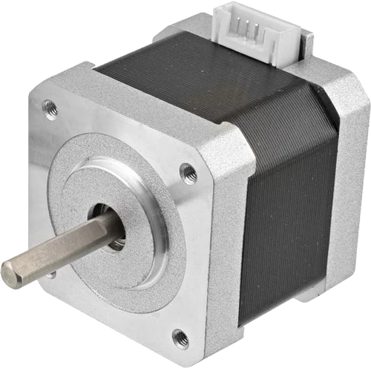
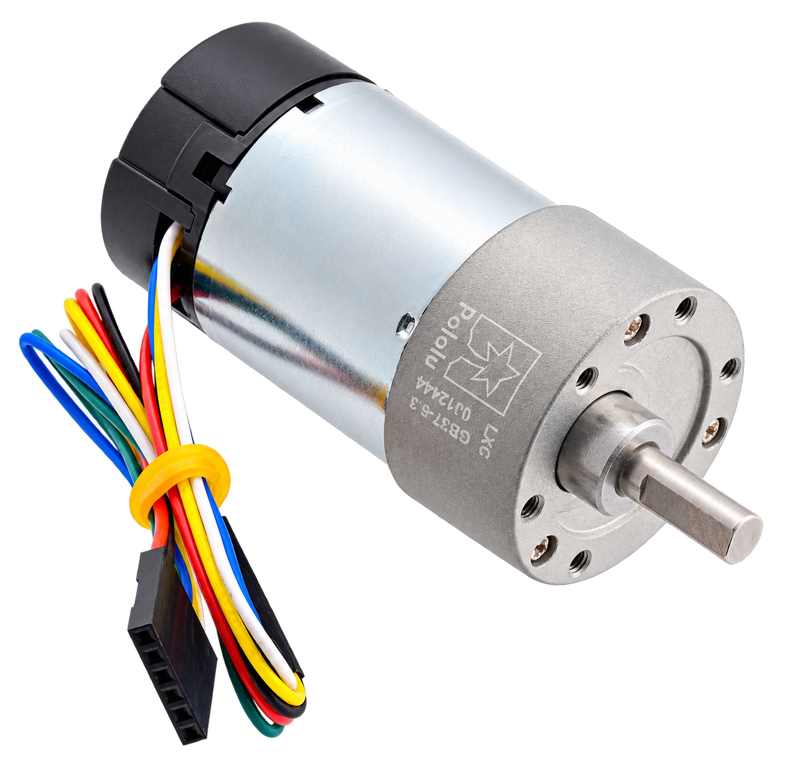
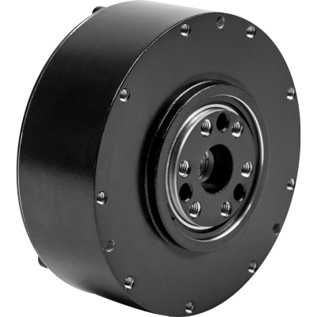
Design Considerations: Motor Selection
Team 27 Preliminary Design Review
University of Massachusetts Amherst
Motor type | Advantages | Drawbacks | Image
Stepper | Affordable High holding torque at low speed. Straightforward position commands. | Slow Poor Efficiency Open loop control – steppers can lose steps under load
Geared DC | Affordable Control is simple Good power efficiency | Gearbox adds weight, friction and losses. Backlash creates lost motion during reversal, making control harder
Brushless DC (BLDC) | Often used in similar designs Backdrivable High RPM and torque Quasi-direct drive gear makes them ast to change directions | Expensive Requires a more complex driver. Performance depends heavily on feedback and controller quality.
Notes:
OD

Slide 31
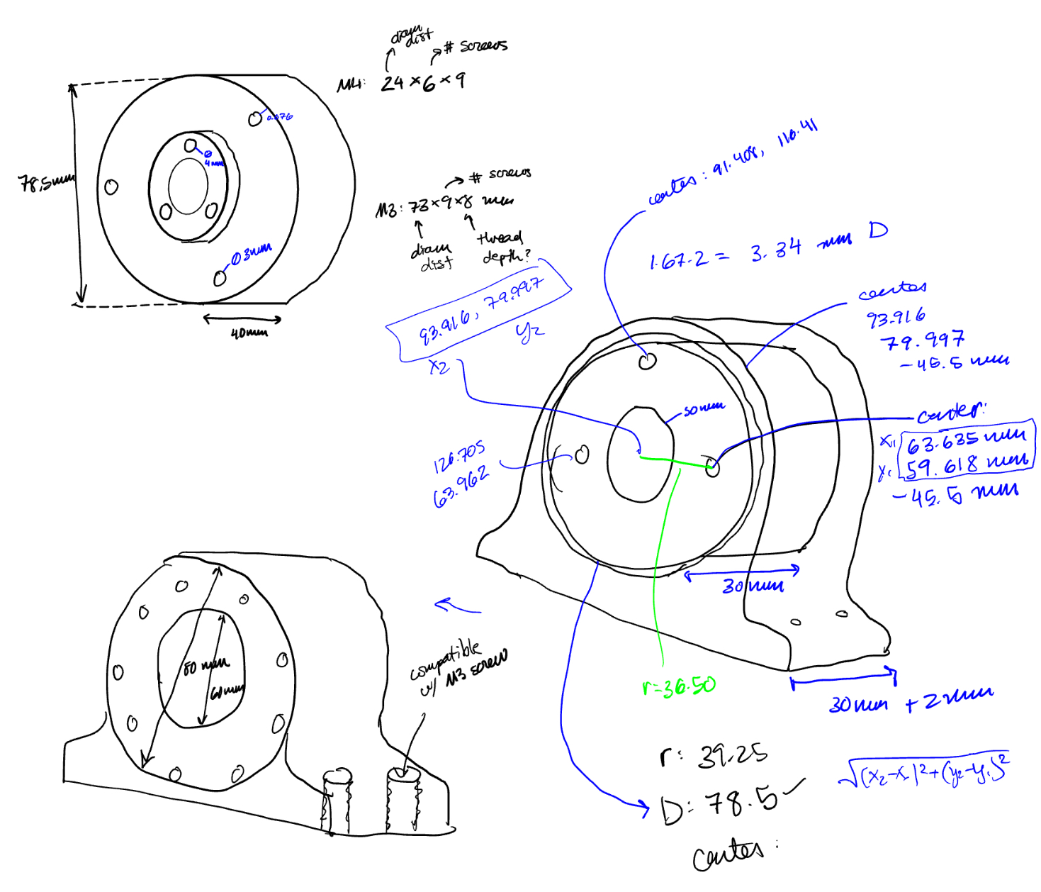
Outline
Team 27 Preliminary Design Review
University of Massachusetts Amherst
Introduction
Survey of Similar Solutions
Preliminary Design Plan
MDR Deliverables
  Overview of Deliverables
  Testing Plan
Project Management
Appendices

Slide 32
MDR Deliverables: Overview
Team 27 Preliminary Design Review
University of Massachusetts Amherst
Populated and tested PCB
Fabricated and assembled PCB integrating the microcontroller, CAN transceiver and protection, IMU, battery monitoring, wheel-driver connections, and 24V to 5V converter
Remote controlled prototype of wheeled robot
Assemble the chassis, legs, and motors
Demonstrate remote-controlled forward and reverse wheel operation with the robot supported.
Learned pushforward map of ergodic coverage algorithm running on MPU
Trained the pushforward map off robot and deployed the learned model on the MPU, with inference performed locally
Recorded inference latency, peak memory use, and coverage error
Notes:
EP

Slide 33
MDR Deliverables: Overview
Team 27 Preliminary Design Review
University of Massachusetts Amherst
Populated and tested PCB
Fabricated and assembled PCB integrating the microcontroller, CAN transceiver and protection, IMU, battery monitoring, wheel-driver connections, and 24V to 5V converter
Remote controlled prototype of wheeled robot
Assemble the chassis, legs, and motors
Demonstrate remote-controlled forward and reverse wheel operation with the robot supported.
Learned pushforward map of ergodic coverage algorithm running on MPU
Trained the pushforward map off robot and deployed the learned model on the MPU, with inference performed locally
Recorded inference latency, peak memory use, and coverage error
Notes:
EP

Slide 34
MDR Deliverables: Overview
Team 27 Preliminary Design Review
University of Massachusetts Amherst
Populated and tested PCB
Fabricated and assembled PCB integrating the microcontroller, CAN transceiver and protection, IMU, battery monitoring, wheel-driver connections, and 24V to 5V converter
Remote controlled prototype of wheeled robot
Assemble the chassis, legs, and motors
Demonstrate remote-controlled forward and reverse wheel operation with the robot supported.
Learned pushforward map of ergodic coverage algorithm running on MPU
Trained the pushforward map off robot and deployed the learned model on the MPU, with inference performed locally
Recorded inference latency, peak memory use, and coverage error
Notes:
EP

Slide 35
Testing Plan for MDR
Team 27 Preliminary Design Review
University of Massachusetts Amherst
Deliverable | Tests | Criteria for success
Printed Circuit Board | Measure power rails, compare battery readings with a multimeter, test sensor and motor interfaces | 1. 5V rail within ±5% under expected load 2. Communication with hip and wheel motors 3. IMU data is consistent
Wheeled Robot | Demonstrate remote-controlled forward and reverse wheel operation with the robot supported. | 1. With the robot supported, demonstrate remote commands that rotate both wheels forward, reverse, and stop.
Onboard Processing | Run identical inputs on the MPU and unity cluster using 3 density maps, with 10 runs per map | 1. All 30 runs complete 2. Outputs agree within 1% relative L2 error
Notes:
HC

Slide 36
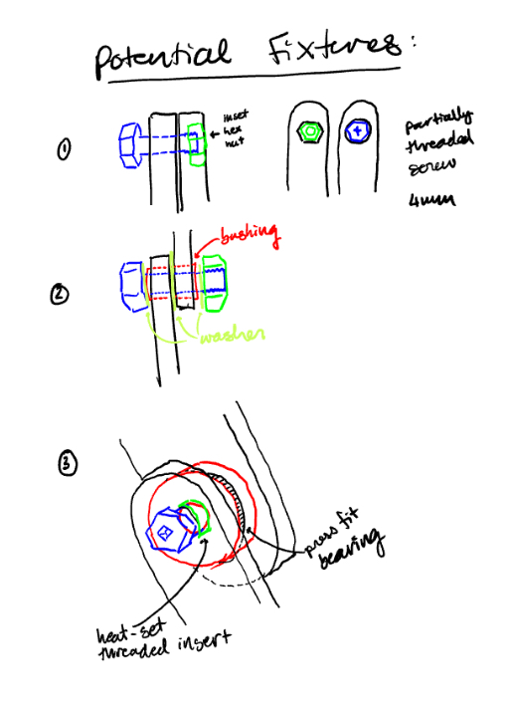
Outline
Team 27 Preliminary Design Review
University of Massachusetts Amherst
Introduction
Survey of Similar Solutions
Preliminary Design Plan
MDR Deliverables
Project Management
  Gantt Chart
  Preliminary Budget Proposal
Appendices

Slide 37
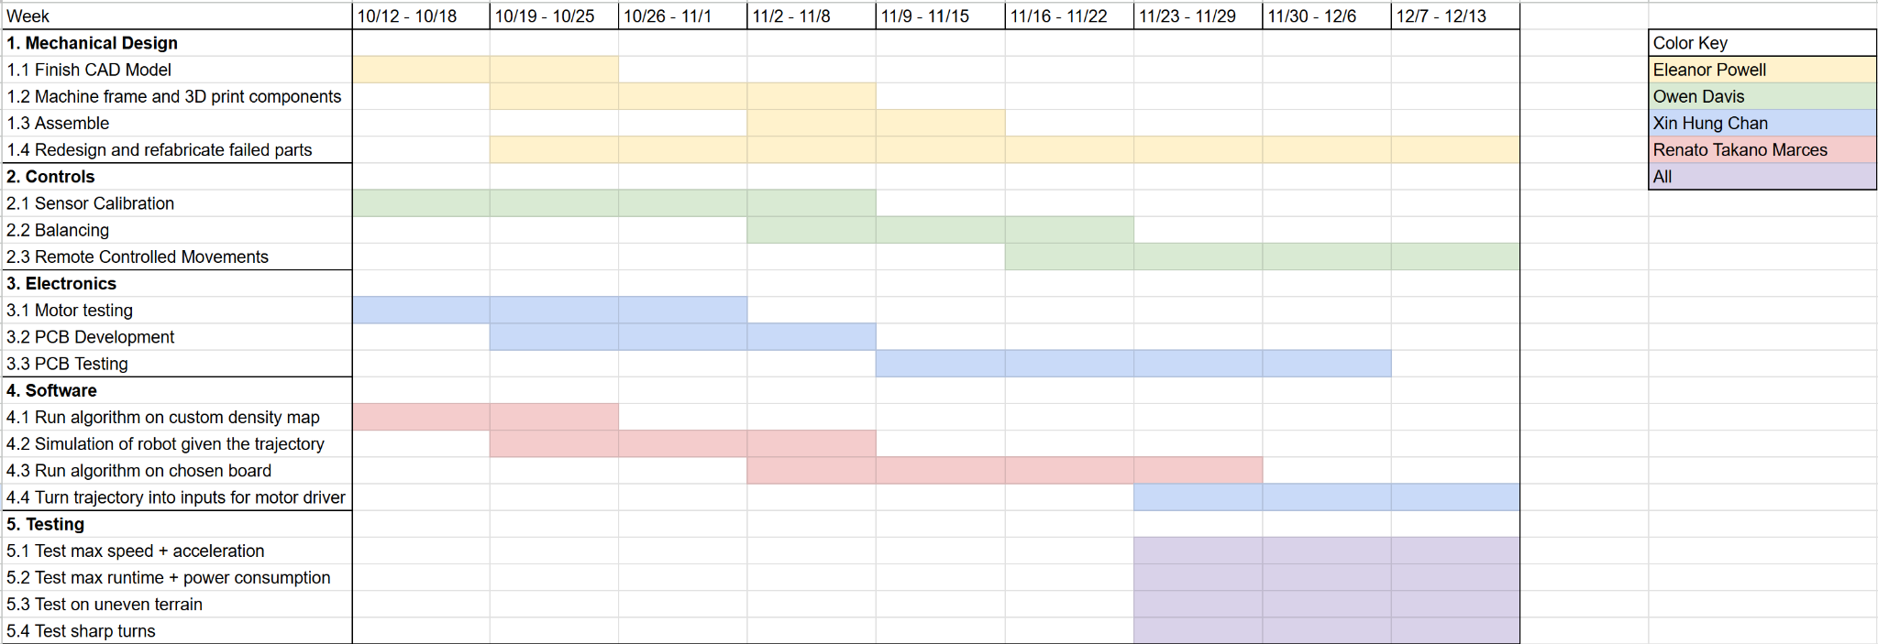
Gantt chart
University of Massachusetts Amherst

Slide 38
Preliminary Budget Proposal
University of Massachusetts Amherst
Electronics
Mechanical parts
Item | Cost/unit | Units | Total Cost
Hip Motor: Rostride 01 | $130 | 2 | $260
Wheel Motor, Wheels, Encoder | $19.89 | 2 | $39.78
PCB | $60 | 3 | $180
Battery | $150 | 1 | $150
Single Board Computer | $0 | 1 | $0
3D Printing Filament | $11 | 1 | $11
Aluminum Sheet Metal, Stock | $4.73 | 1 | $4.73
Bearings | $6.91 | 4 | $27.64
Threaded Bushings | $0.76 | 1 | $0.76
Fully threaded Hex Cap Screw | $10.97 | 1 | $10.97
Hex Nut | $4.43 | 6 | $26.58
Total Cost: |  |  | $711.46

Slide 39
Thank you! Questions?
Team 27 Preliminary Design Review
University of Massachusetts Amherst
Actual Trajectory
Target Trajectory

Slide 40
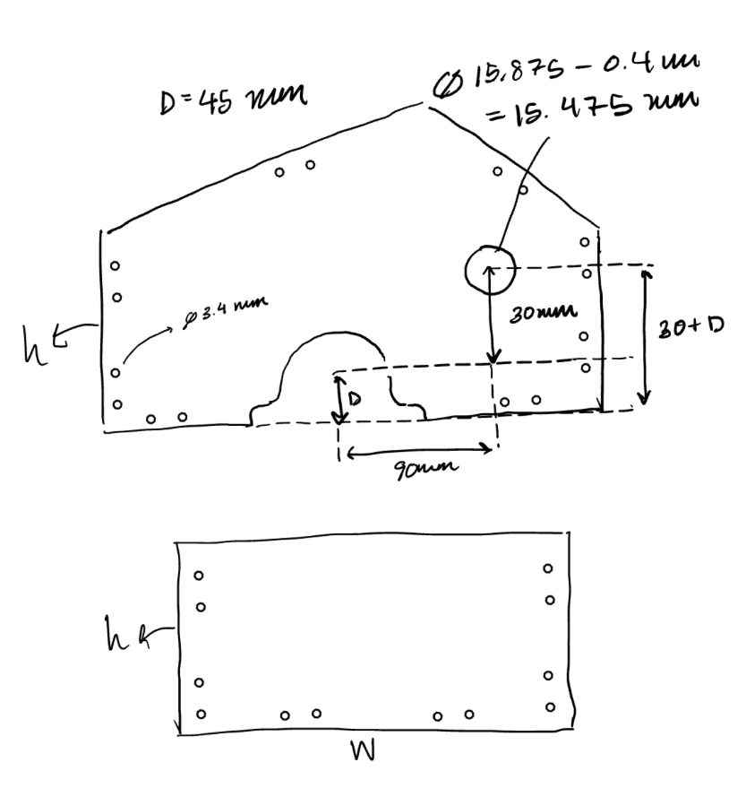
Outline
Team 27 Preliminary Design Review
University of Massachusetts Amherst
Introduction
Survey of Similar Solutions
Preliminary Design Plan
MDR Deliverables
Project Management
Appendices
  Appendix A: Calculations
  Appendix B: References
  Appendix C: Additional Slides

Slide 41
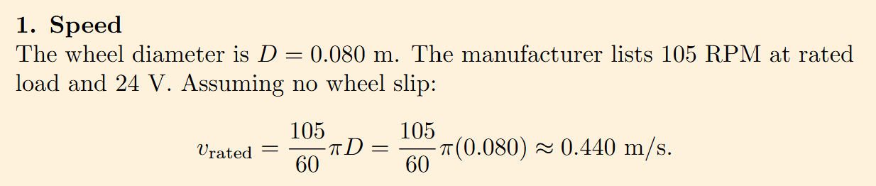
Appendix A: Calcs
Team 27 Preliminary Design Review
University of Massachusetts Amherst

Slide 42
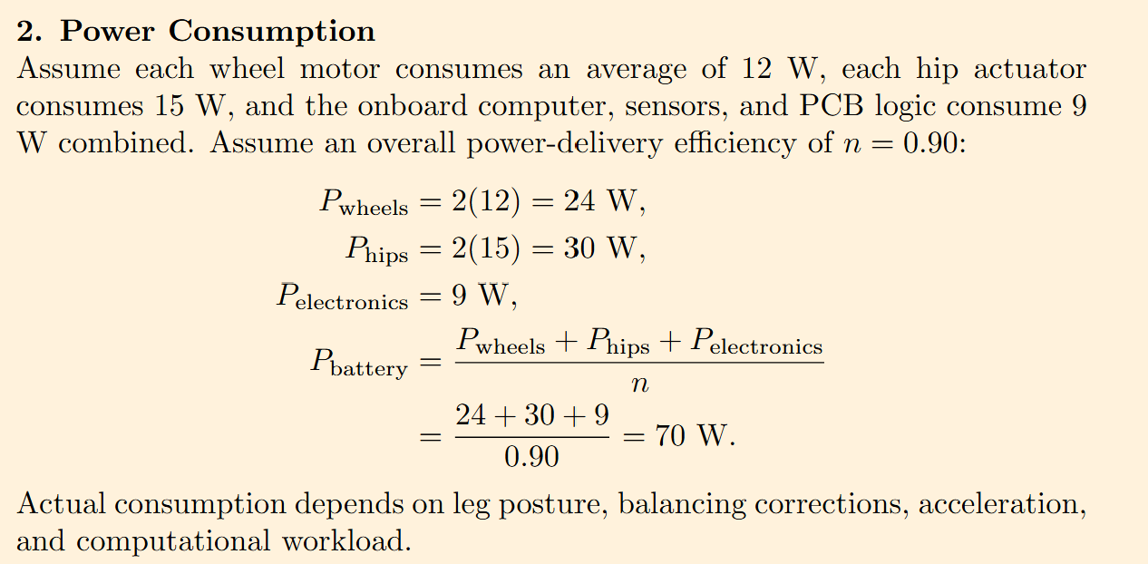
Appendix A: Calcs
Team 27 Preliminary Design Review
University of Massachusetts Amherst

Slide 43
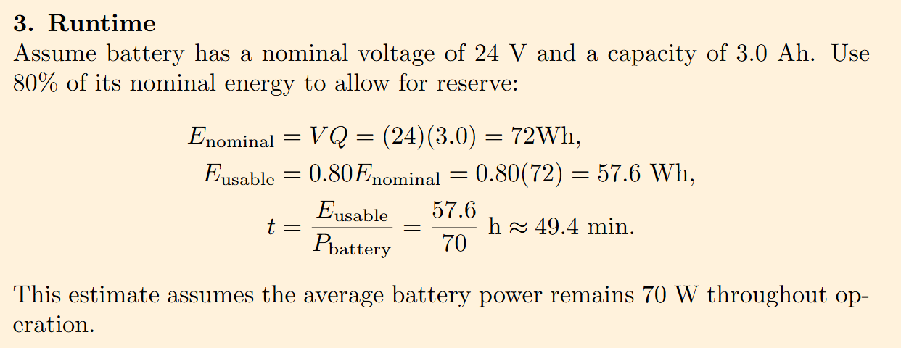
Appendix A: Calcs
Team 27 Preliminary Design Review
University of Massachusetts Amherst

Slide 44
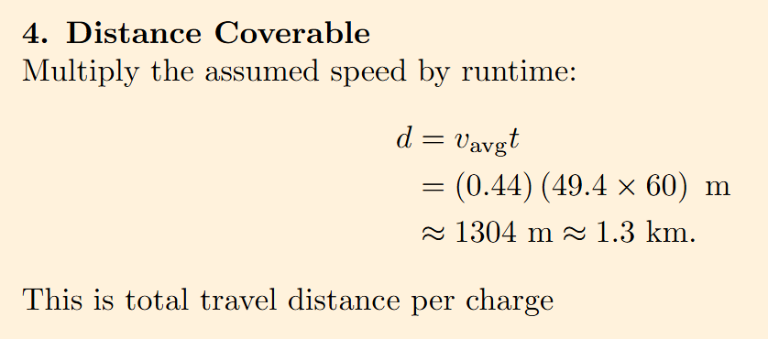
Appendix A: Calcs
Team 27 Preliminary Design Review
University of Massachusetts Amherst

Slide 45
Appendix B: References
Team 27 Preliminary Design Review
University of Massachusetts Amherst
[1] Sun, M., Pinosky, A., & Murphey, T. (2025). Flow matching ergodic coverage. Robotics: Science and Systems XXI.
https://doi.org/10.15607/rss.2025.xxi.051
[2] Hughes, C., Liu, Y., Lahrach, Y., Engdahl, J., Warren, H., Lee, D., Ramos, F., Miles, T., & Abraham, I. (2026).
Asymptotically optimal ergodic coverage on generalized motion fields. Robotics: Science and Systems XXII. https://doi.org/10.15607/rss.2026.xxii.136
[3] Dong, D., Berger, H., & Abraham, I. (2023). Time Optimal Ergodic Search. Robotics: Science and Systems XIX.
https://doi.org/10.15607/rss.2023.xix.082

Slide 46
Appendix C: Additional Slides
Team 27 Preliminary Design Review
University of Massachusetts Amherst
But wait… There’s more!!

Slide 47
PCB Plan
Team 27 Preliminary Design Review
University of Massachusetts Amherst
Control and Communication | Sensing and Monitoring | Power Conversion
Microcontroller - runs balance and motor-control loops | IMU - measures body acceleration and angular velocity | 24V to 5V buck converter - supplies low-voltage electronics
CAN transceiver + protection - communicates with the hip actuators and protects CAN lines | Battery monitoring - measures battery voltage and current
Wheel-driver connections - carry PWM, direction and enable signals to wheel drivers
Notes:
Chopping Block: Is this just the table version of what is one the previous slide? If so, move it to appendix.

Slide 48
MPU Considerations
University of Massachusetts Amherst
Board | Main Advantages | Main Limitations
Arduino UNO Q | Combines a Linux processor and a separate STM32 microcontroller on one board Allows planning and motor control to run on different processors Free! | Less CPU headroom than the other boards. AI acceleration depends on software compatibility
Jetson Nano | Supports CUDA. Useful for neural-network inference Looks cool | Older CPU and limited memory Expensive
Raspberry Pi 5 | Strong general purpose computing. Lots of support | No onboard CUDA GPU or dedicated neural-network accelerator means inference may be challenging

